Slide 1
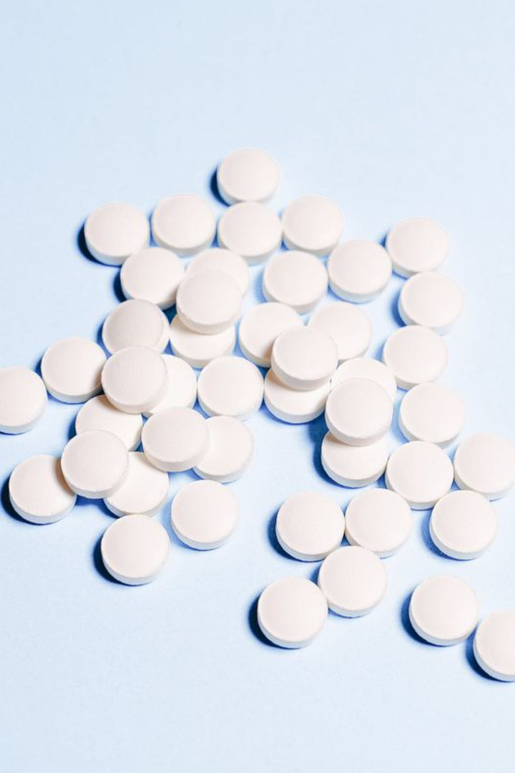
Missing Pills

Slide 2
Project Description
1
Counting object
2
Find the missing pills
The main idea for our project to detect and count the missing pills
Result after we create suitable code.
3
Try functions
4
Finally
More time to get the result without any noise
We got the missing pills and count them

Slide 3

Project Idea
1
Think how to find objects from picture
Think how we count the objects and find the difference
2
3
Finally we got the missing pills and count them

Slide 4
Code
1)i = imread('tablets.jpeg');
5)threshold = 130; bw = g > threshold;
9)subplot(2, 2, 4); imshow(afterOpening); title('After Opening');
2)figure; subplot(2, 2, 1); imshow(i); title('Original Image');
6)image subplot(2, 2, 3); imshow(bw); title('Thresholded Image');
10)[L, num] = bwlabel(afterOpening, 4);
3)g = rgb2gray(i);
4)subplot(2, 2, 2); imshow(g); title('Grayscale Image');
11)missedPills = 15 - num;
7)se = strel('disk', 7);
12)disp(['Number of pills missed: ' num2str(missedPills)]);
8)afterOpening = imopen(bw, se);

Slide 5
code description
imread('tablets.jpeg');
Read the image
figure; subplot(2, 2, 1); imshow(i); title('Original Image');
% Display the original image
g = rgb2gray(i)
% Convert the image to grayscale
subplot(2, 2, 2); imshow(g); title('Grayscale Image');
% Display the grayscale image

Slide 6
code description
threshold = 130;
bw = g > threshold;
% Threshold the grayscale image
subplot(2, 2, 3); imshow(bw); title('Thresholded Image');
% Display the thresholded image
se = strel('disk', 7);
% Create a disk-shaped structuring element

Slide 7
code description
afterOpening = imopen(bw, se);
% Perform morphological opening
subplot(2, 2, 4); imshow(afterOpening); title('After Opening');
% Display the result after opening
[L, num] = bwlabel(afterOpening, 4);
% Label connected components
missedPills = 15 - num;
disp(['Number of pills missed: ' num2str(missedPills)]);
% Display the number of pills missed in the command window

Slide 8
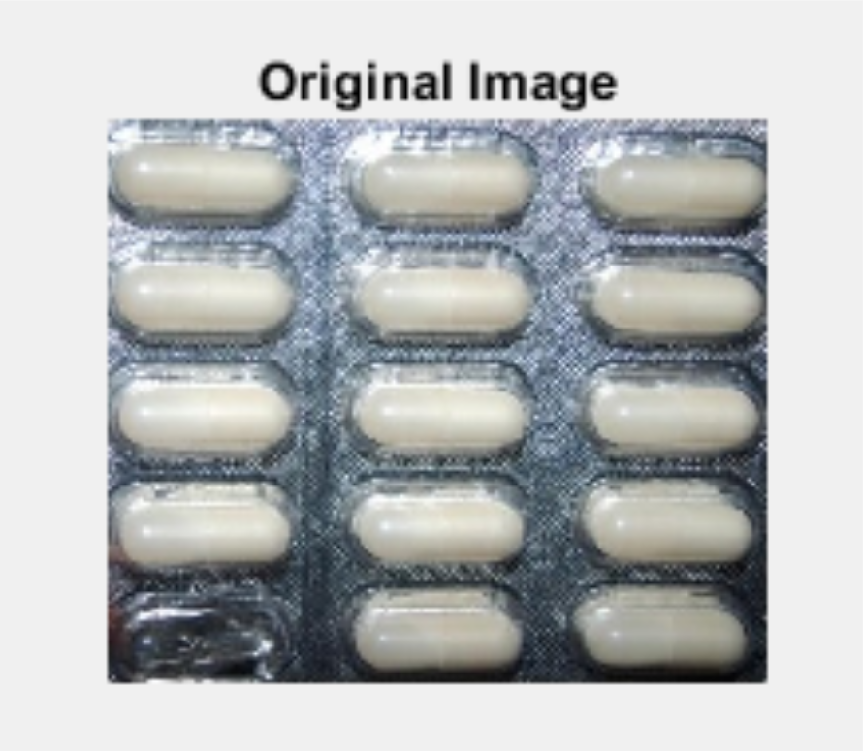
Screenshot of Runs

Slide 9
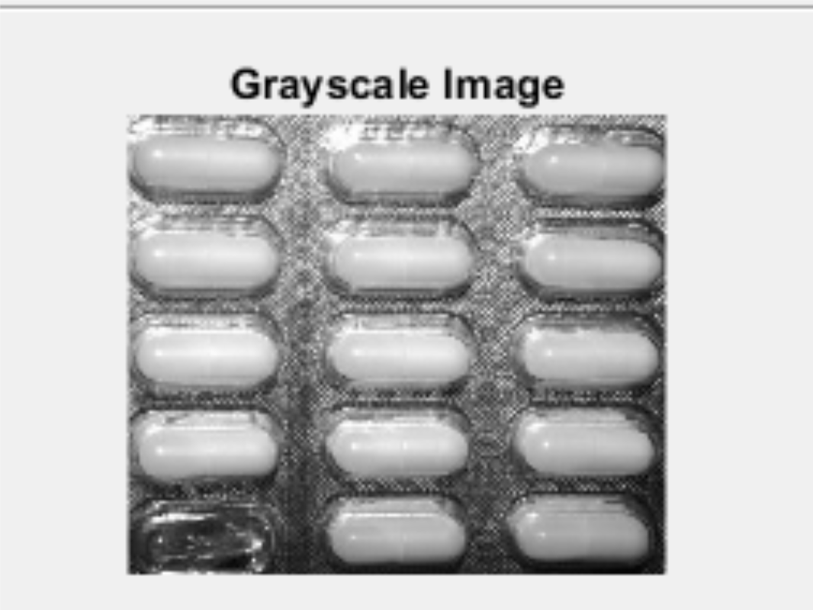
Screenshot of Runs

Slide 10
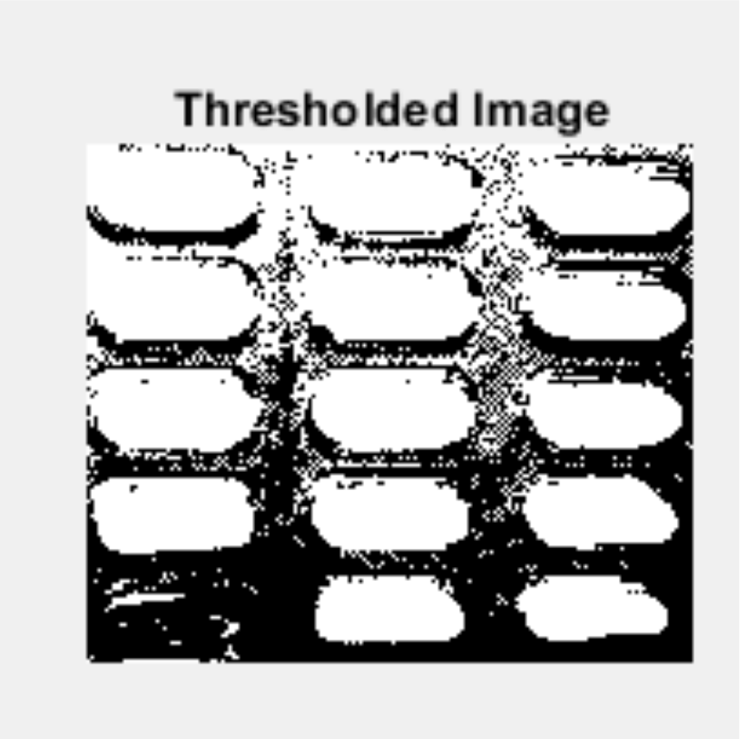
Screenshot of Runs

Slide 11
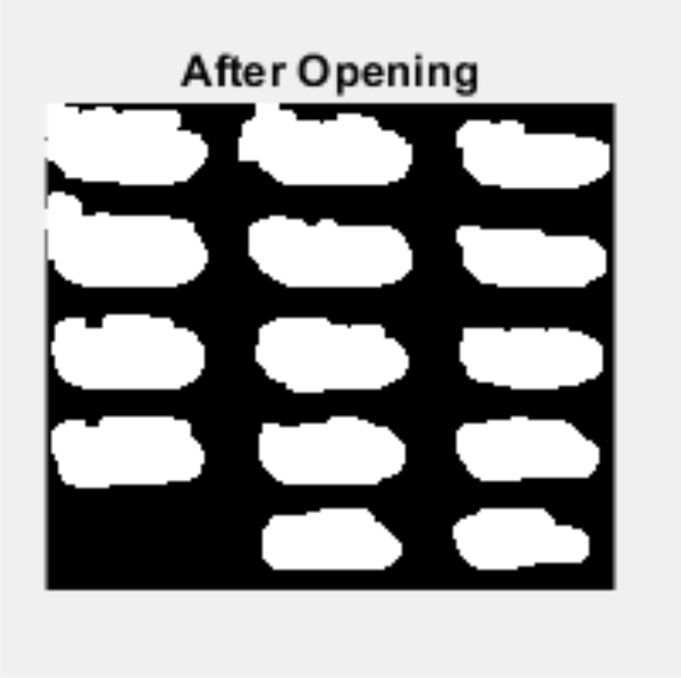
Screenshot of Runs

Slide 12
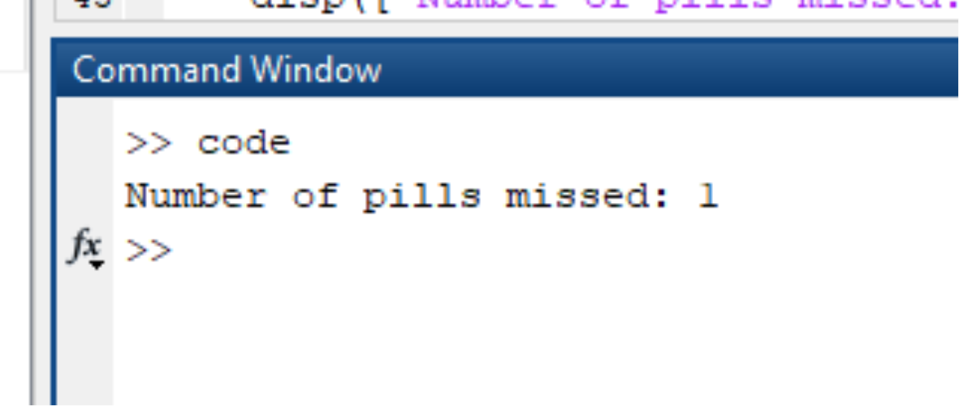
Screenshot of Runs

Slide 13

Thank You

